Slide 1
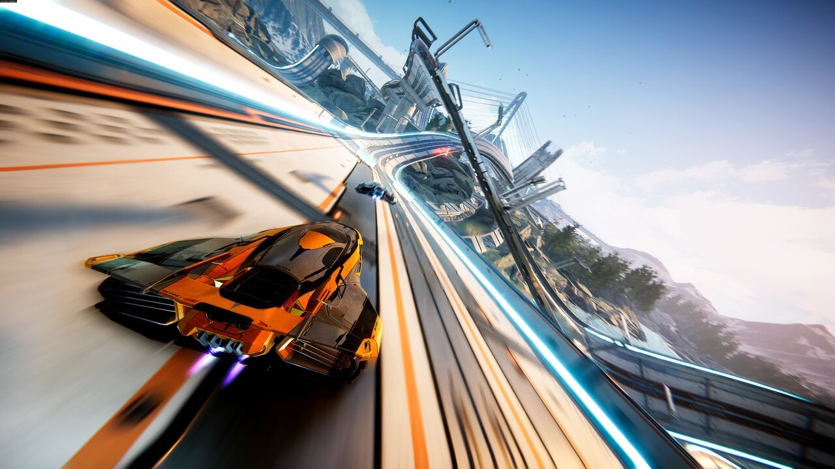


Slide 2
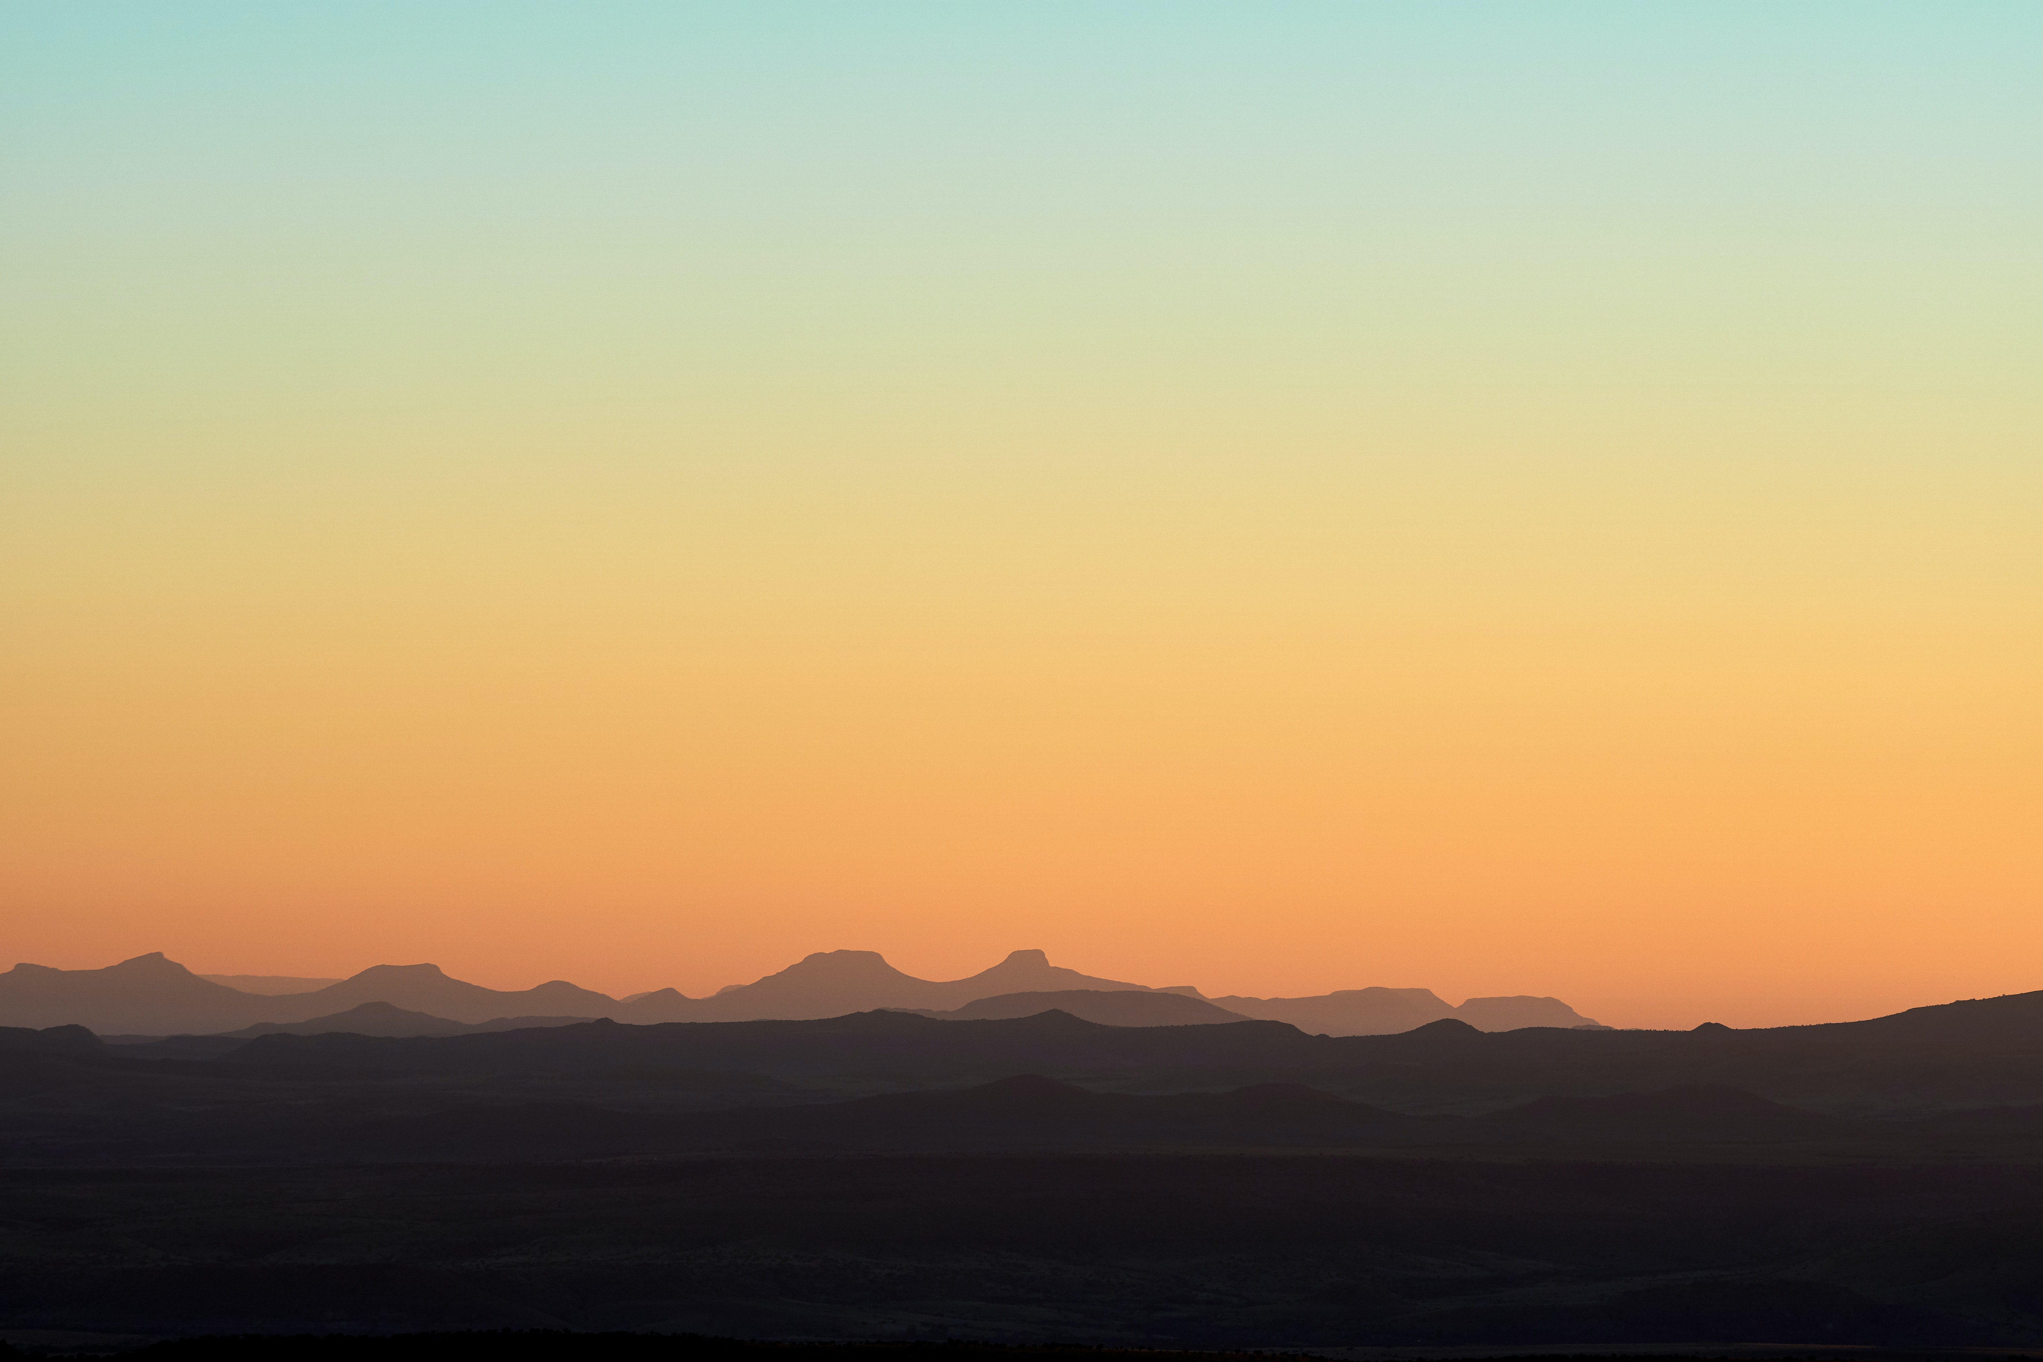
About Leviator
Leviator is unity based game created using C sharp language and comprises of a single 3D scene .
The game is based on simulation and arcade playstyle.
The game can be restarted by pressing the ‘R’ key , the jet can be controlled by using basic ‘w’,’a’,’s’,’d’ keys .These keys can be changed according to player’s need.
Player can press ‘escape’ key in order to exit the game at any moment .

Slide 3
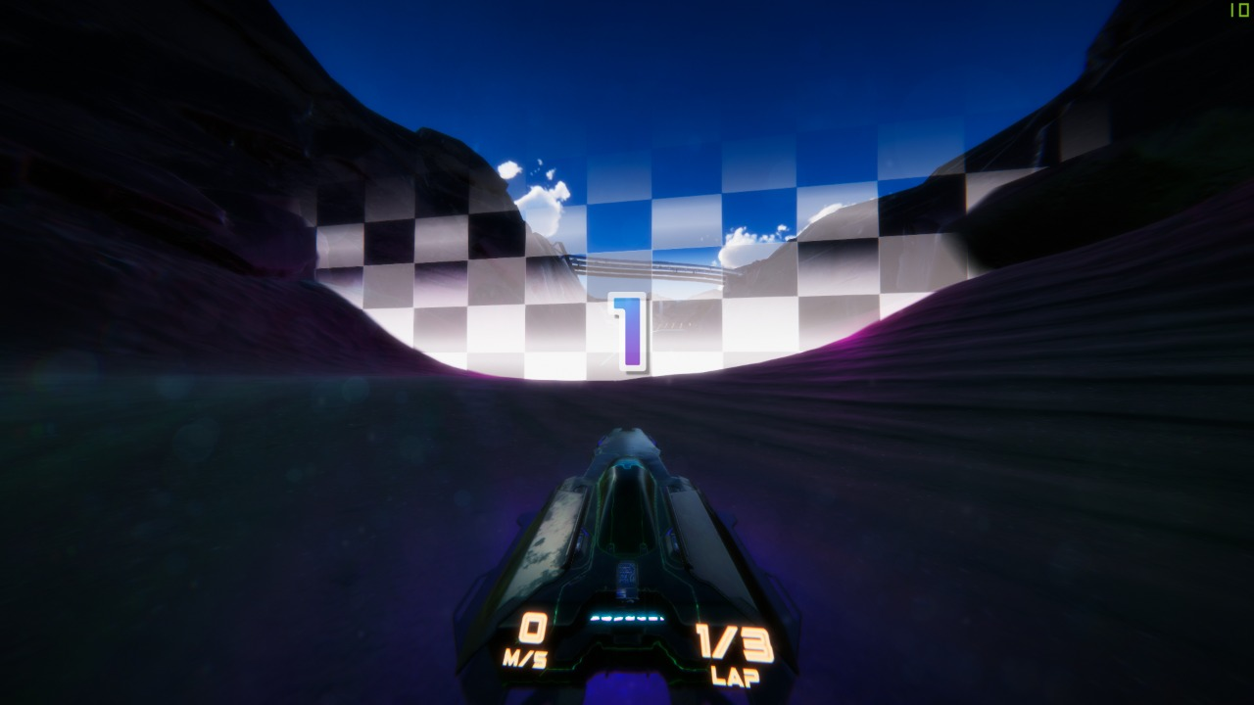

Slide 4
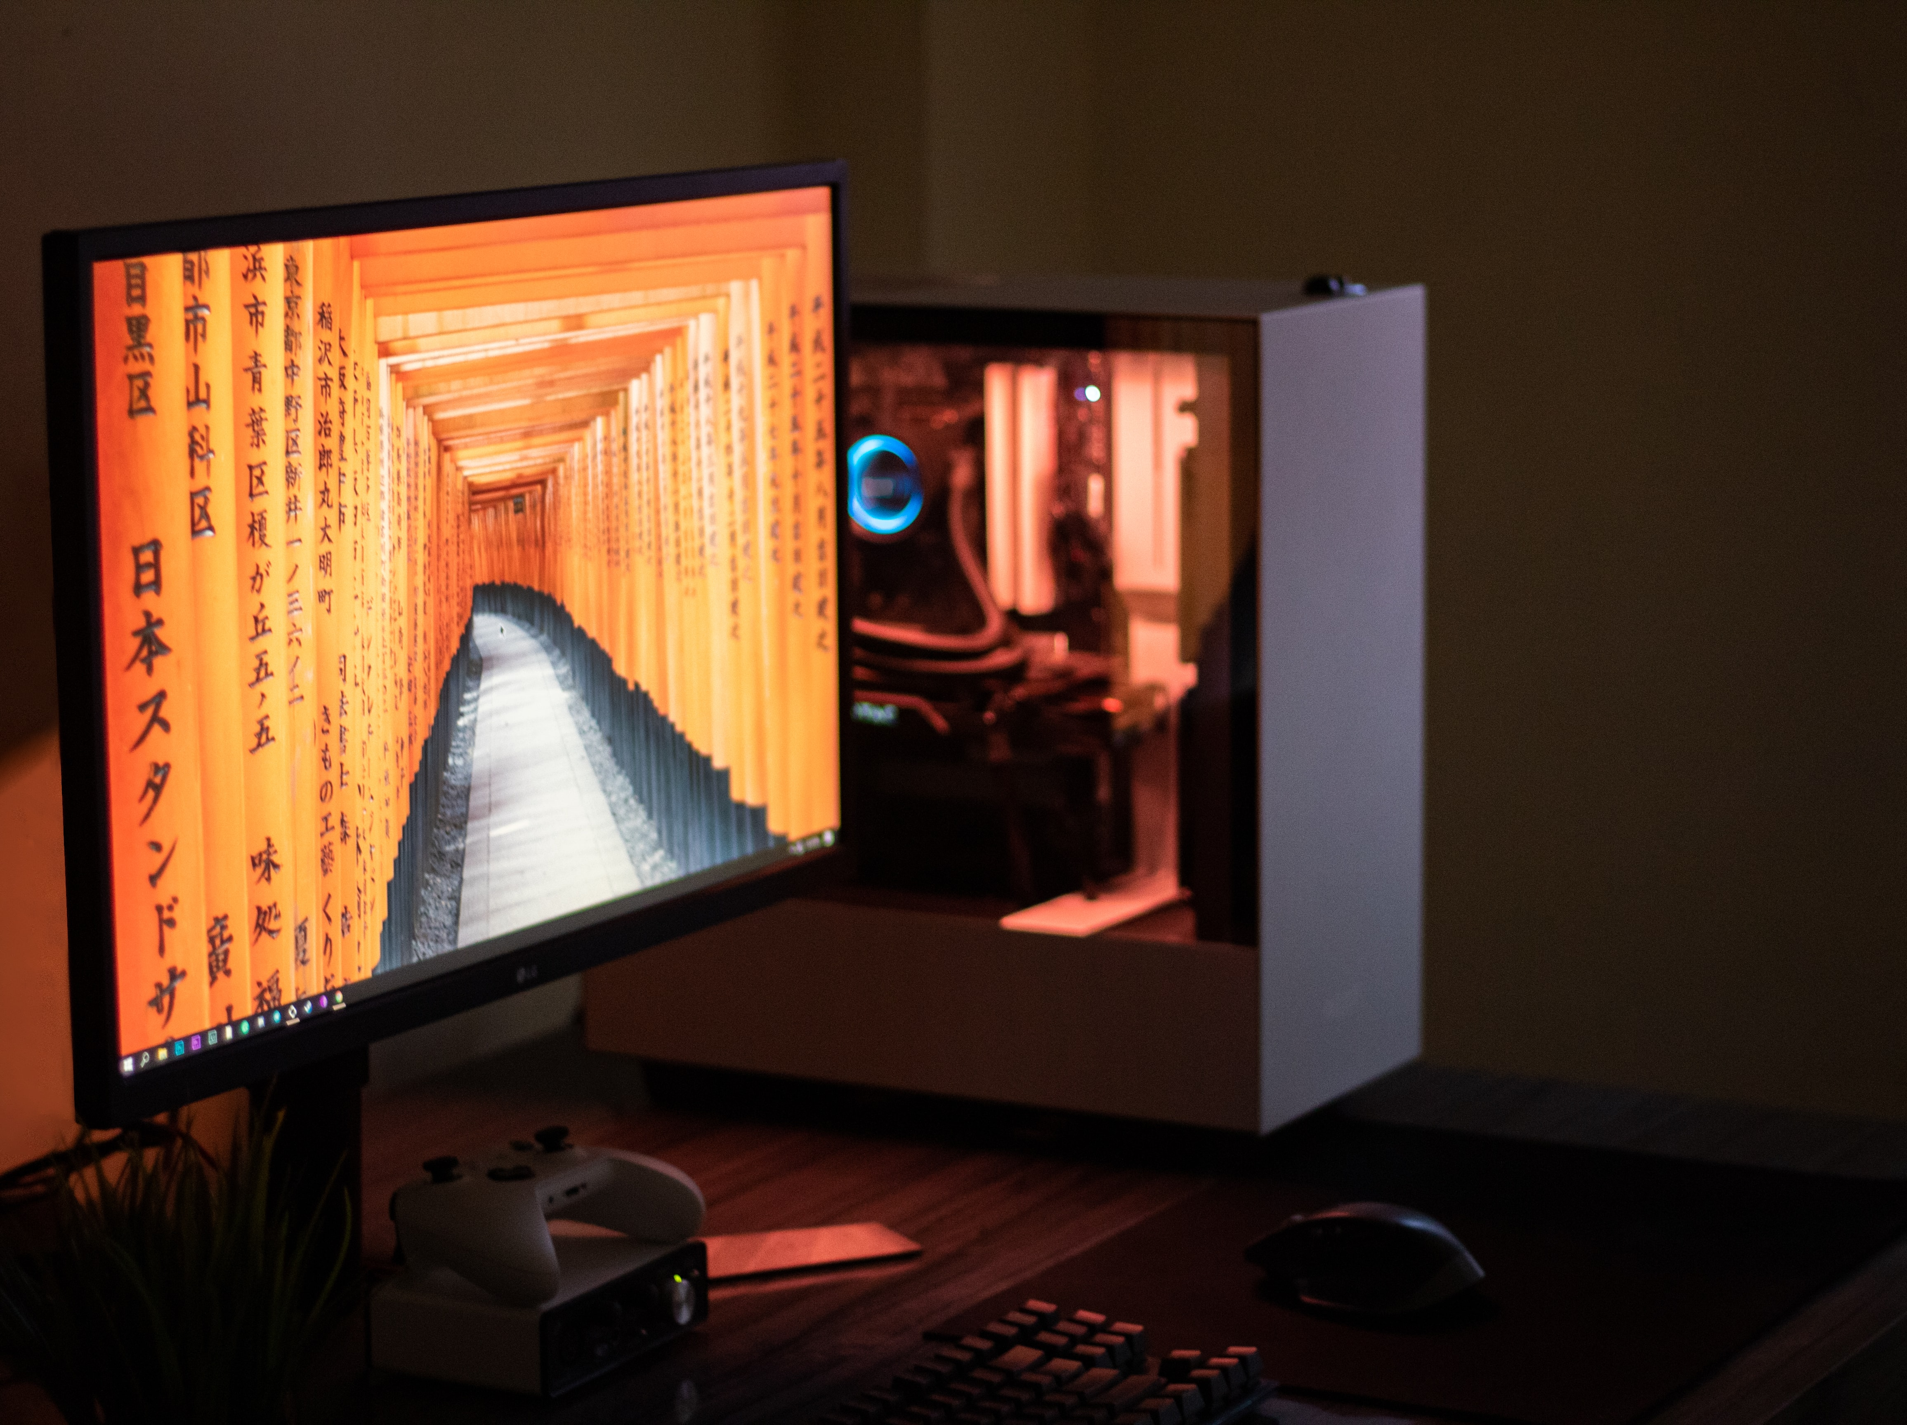
Software Requirements and their application
Unity Game Development
Blender
Adobe Illustrator
Adobe Photoshop
Visual Studio or Visual Code

Slide 5
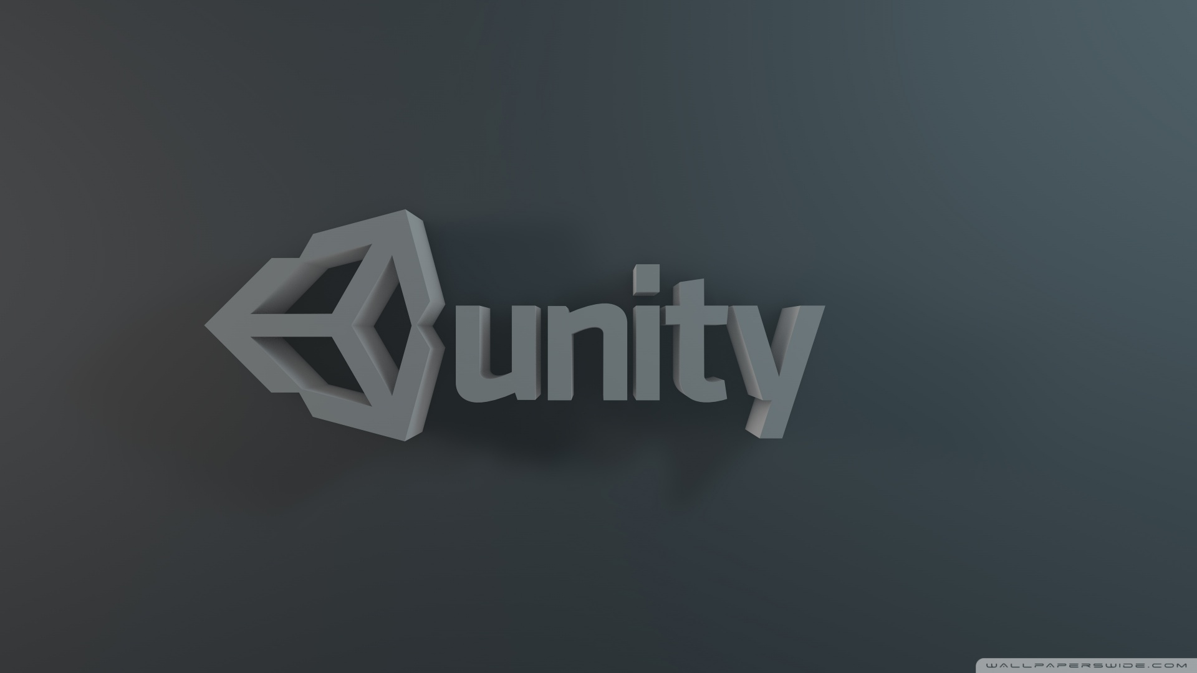
Unity Game development
Basic game development software
Provides a base for creating games
Completely user friendly and uses C sharp language
It was the main software behind the creation of Leviator .
Moreover unity provides the asset store in order to access free already created assets and import them directly in the project .

Slide 6
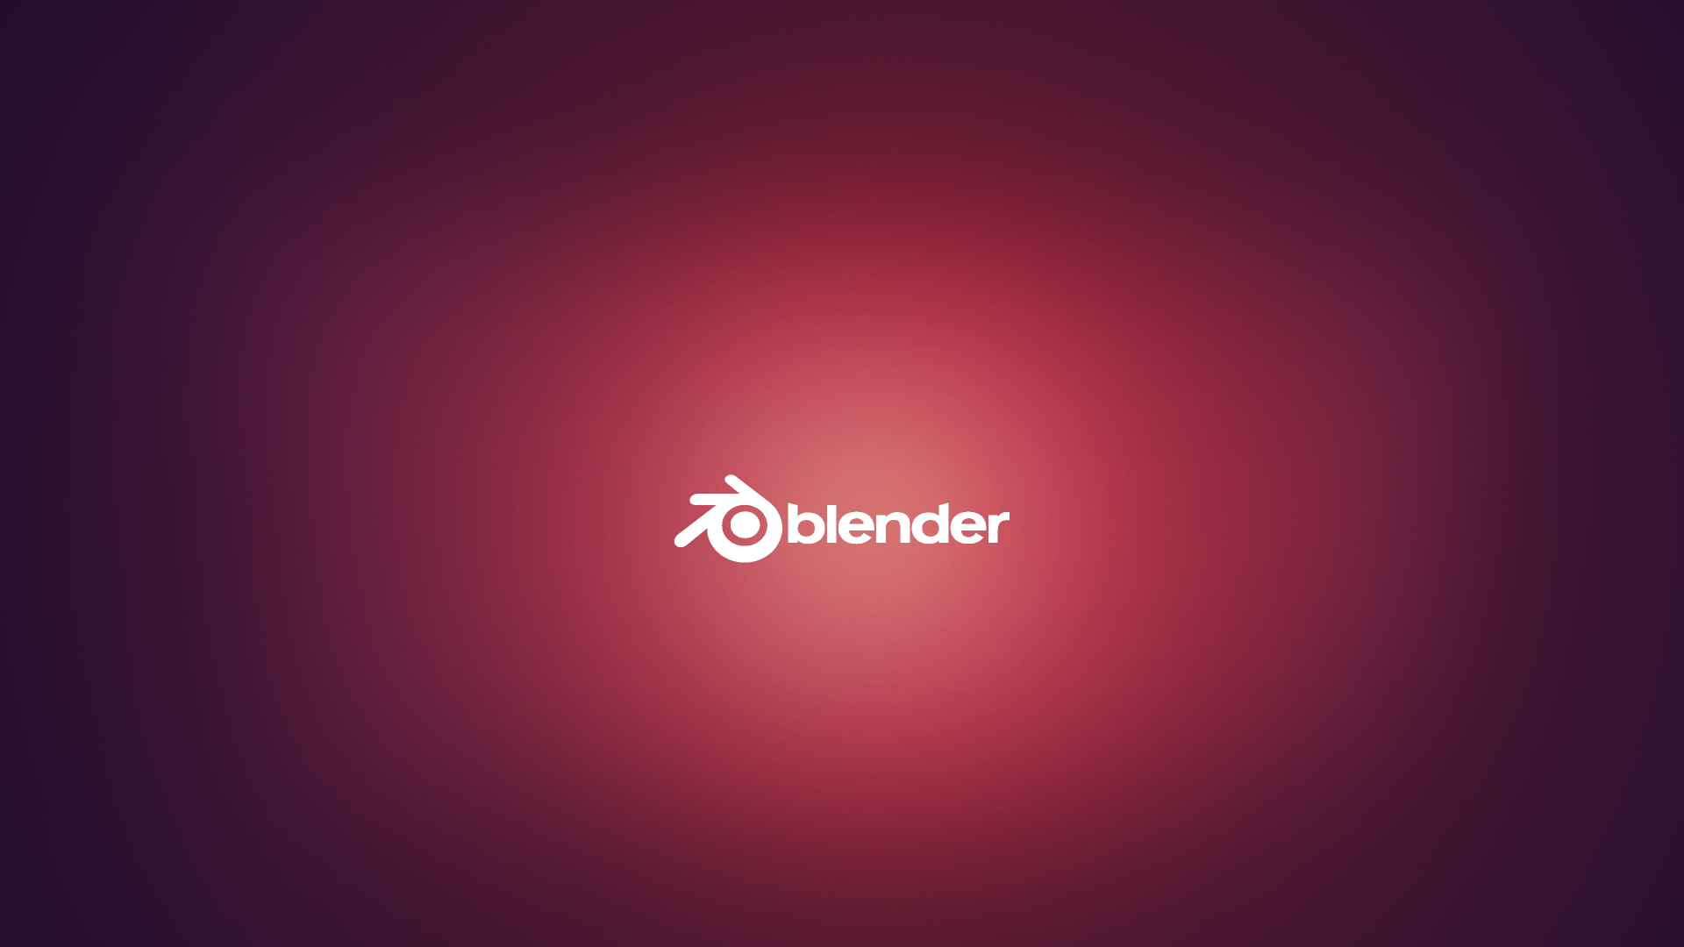
Used to create elements of a game in 3d
Also used to create animation clips that are completely created using blender animations
In Leviator , blender was used to create the start menu button graphics and the most important part of the game – the jet .

Slide 7
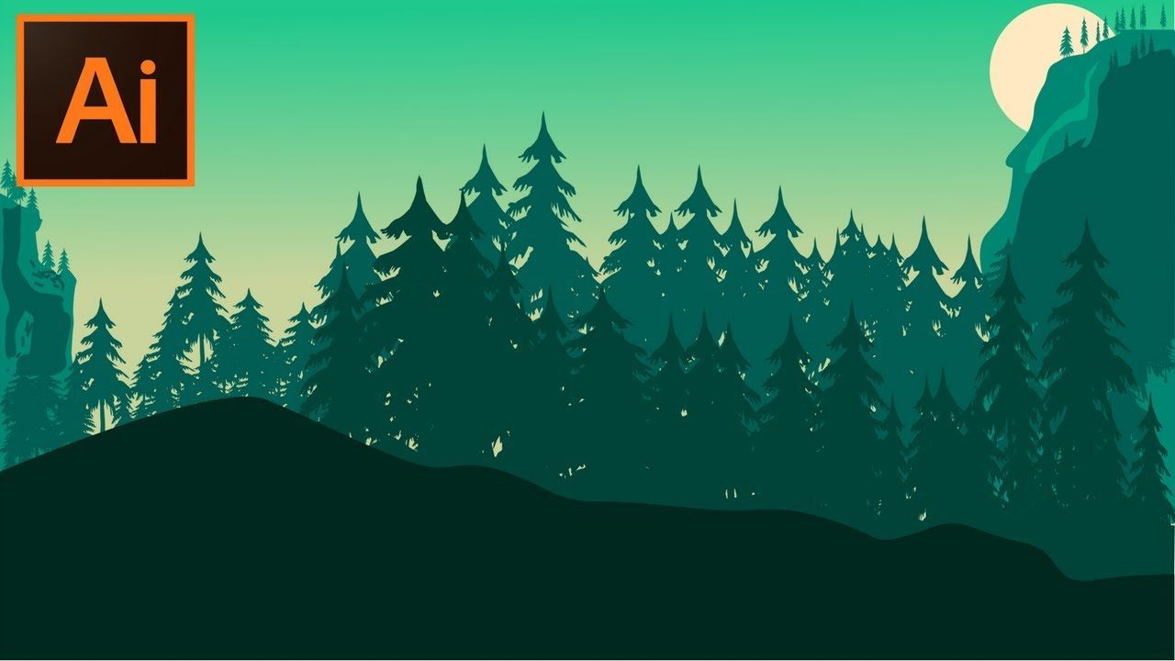
Adobe illustrator
Used to create vector graphics and is a design program
Used by content creators and game developers because of varied filters and operations
Was used in Leviator to create the button sprites for restarting of the game .
The countdown was also created by using some parts of adobe illustrator itself .

Slide 8
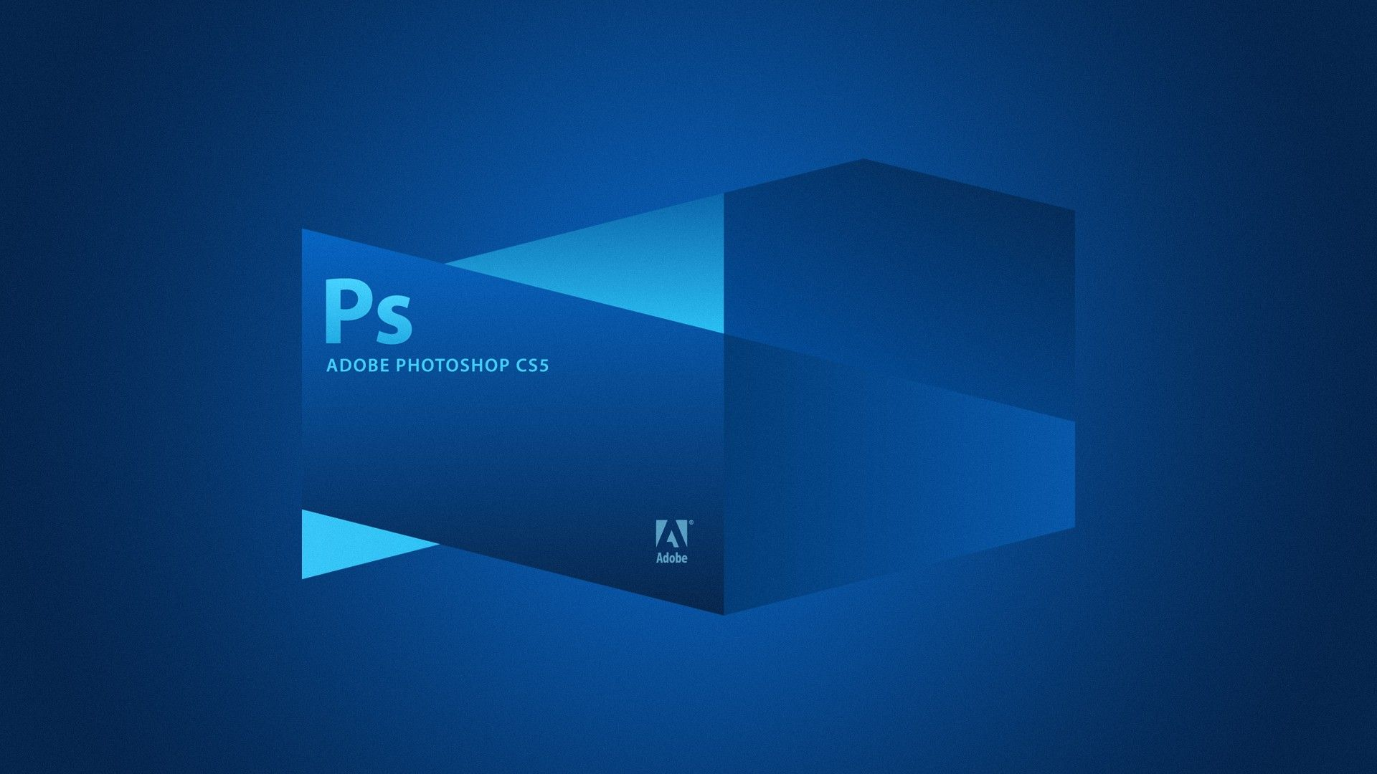
Adobe Photoshop
It is a raster graphics editor and is used to edit already created pictures or vector graphics
In Leviator , it was used to create the background that has 3 different layers each on the upper side and the lower side
Because of photoshop the color editing and copying was made very easy

Slide 9
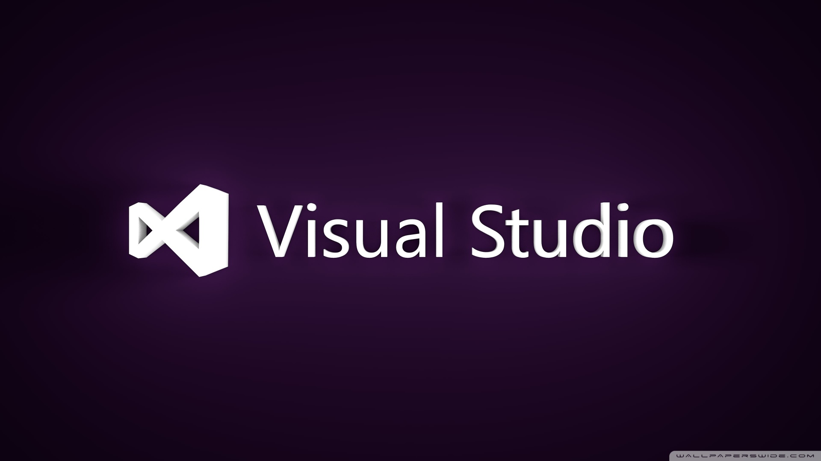
Microsoft Visual Studio
As the games need scripts to make basic movements or in order to perform a particular task in a game , scripts are used by unity that are coded in C sharp language.
Microsoft Visual studio enables the user to use various programming languages just by adding their extension .
Unity uses visual studio as the basic script editor .

Slide 10
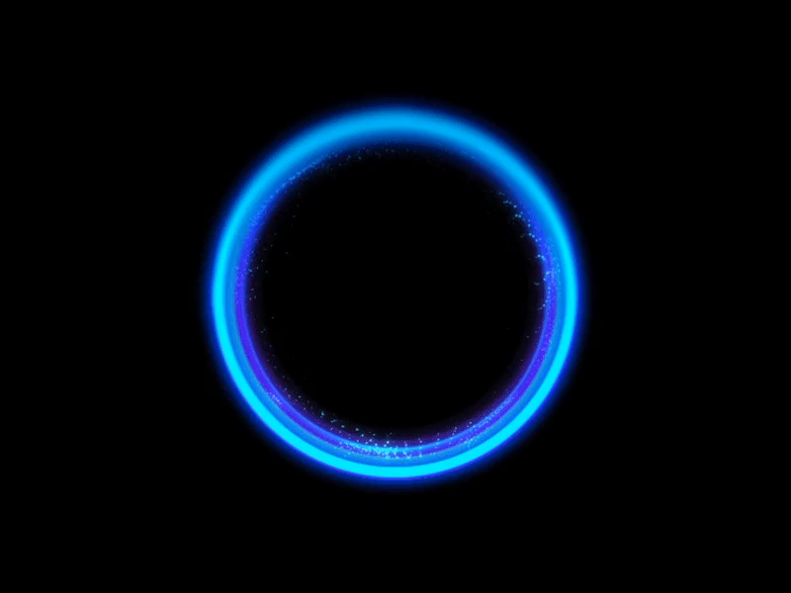
Audio
Each scene has a different audio some of which trigger automatically and some trigger when player presses a specific key or does a specific task .
Each audio has been created by using audacity software and in unity the audio is managed by the “audiomanager” that works on the basis of a script .

Slide 11
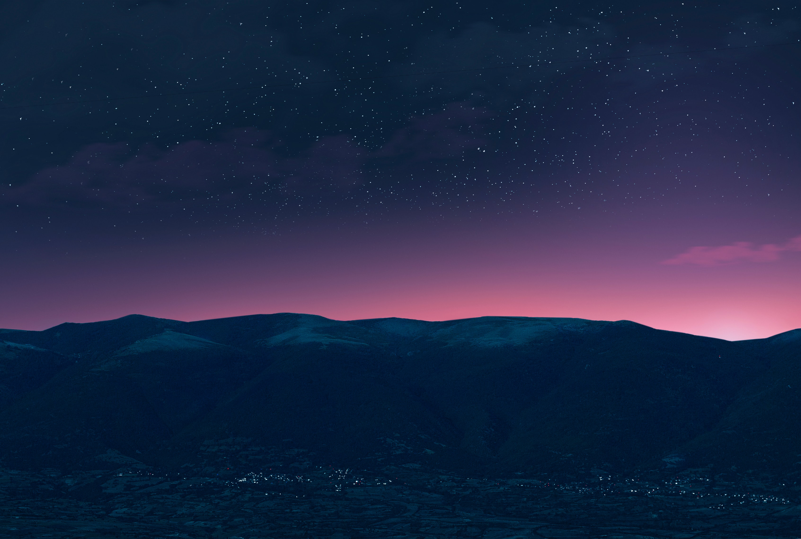
Scene 1 : The Cinemachine
The first scene comprises of the cinemachine effect .
Cinemachine gives the game a complete new look and is used to beautify and present the game in a much more explained way.
Cinemachine is a tool provided by unity that plays a video type enterance as the game begins or ends .
It plays the video between 2 to 3 points as per user’s will and is very easy to customize .

Slide 12
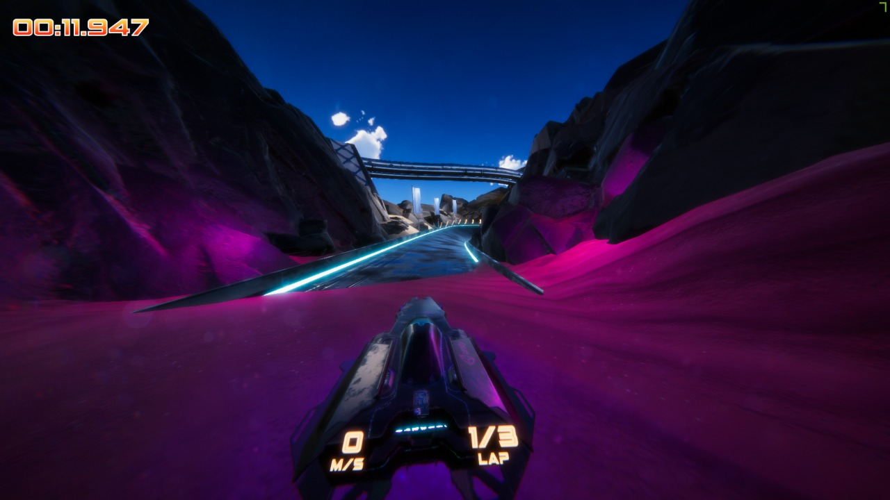

Slide 13

Scene 2 : The Game
Scene 2 is the main game where the player will be controlling a jet and the main objective is to complete the laps in minimum amount of time without touching the obstacles .
On the jet itself , its speed and the ongoing lap is displayed .
Speed of the jet decreases if it hits the track or any of its component .
There are 3 laps in the game at the end of which high score along with an option to restart is displayed.

Slide 14
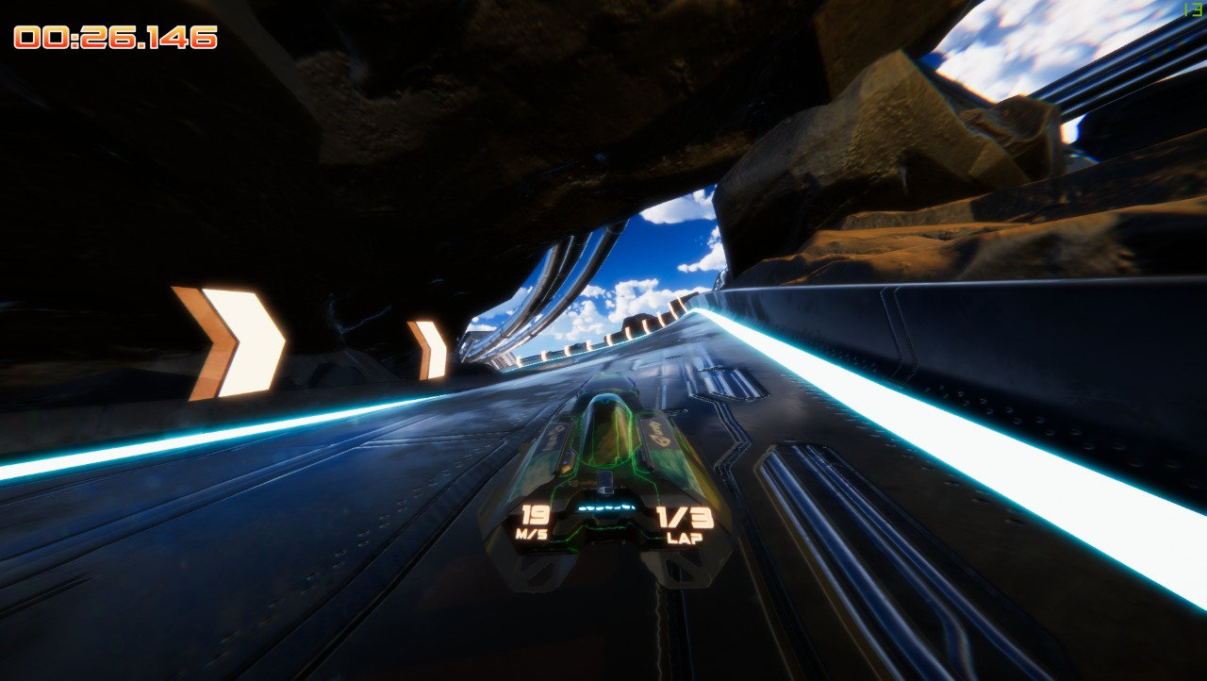

Slide 15

The Main Scene
The main scene is displayed before the game begins .
It is created to be a user friendly interface where users can change the in-game settings according to the user .
Using the main scene , the user can change the graphics quality of the game .
Moreover, the basic controls of the game can also be changed using the main scene .
Monitor type can also be changed if the user wishes to play on an external monitor .

Slide 16
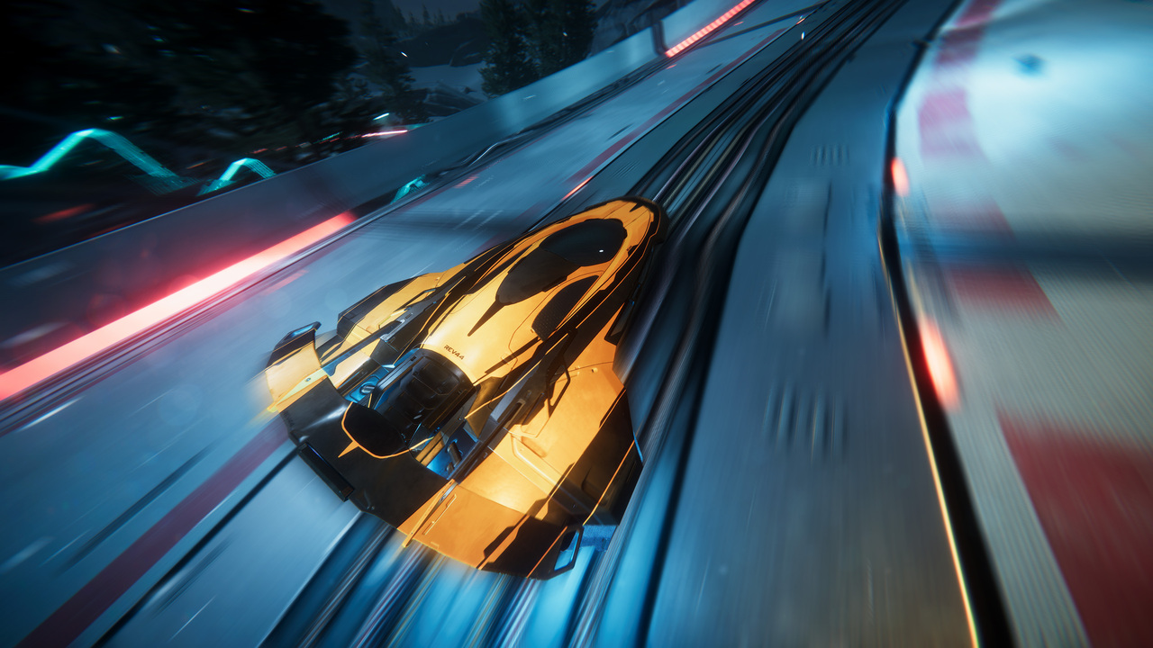
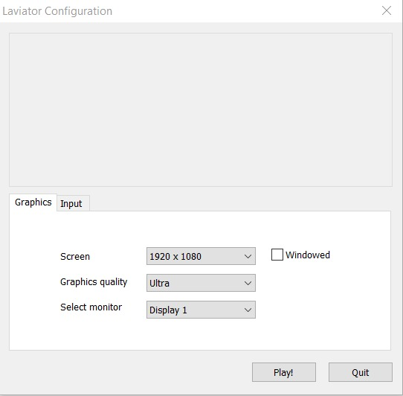

Slide 17
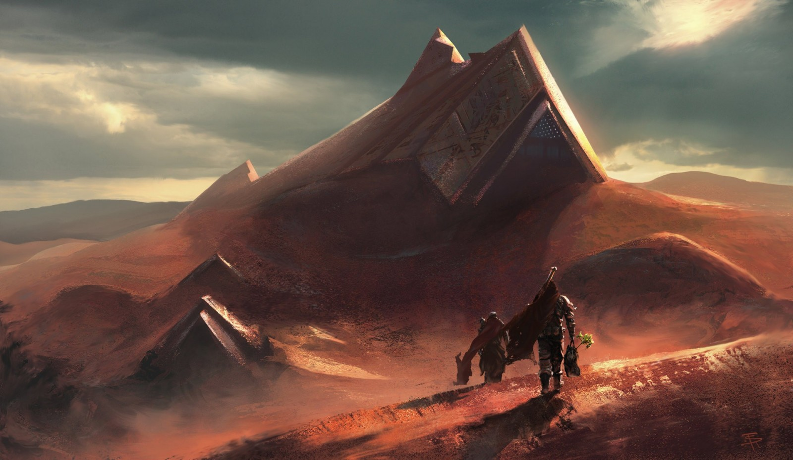
The Terrain
A desert type terrain has been used for leviator .
The terrain itself was created using blender software .
The game has been kept as a night-type gameplay execution.
The terrain comprises of rocks , bushes and the sand dunes that were all designes in blender and later inserted in the main game .

Slide 18
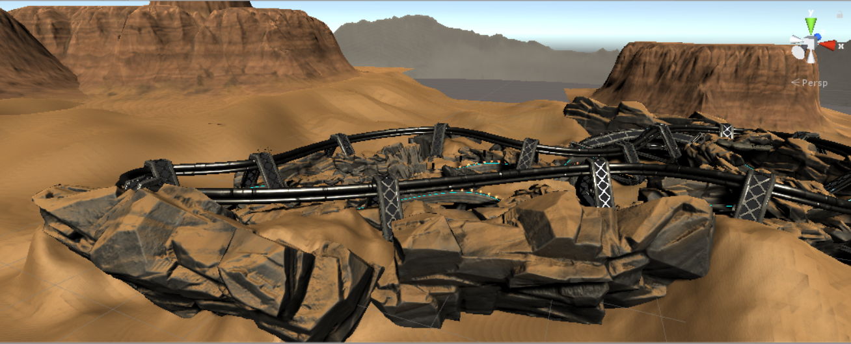

Slide 19
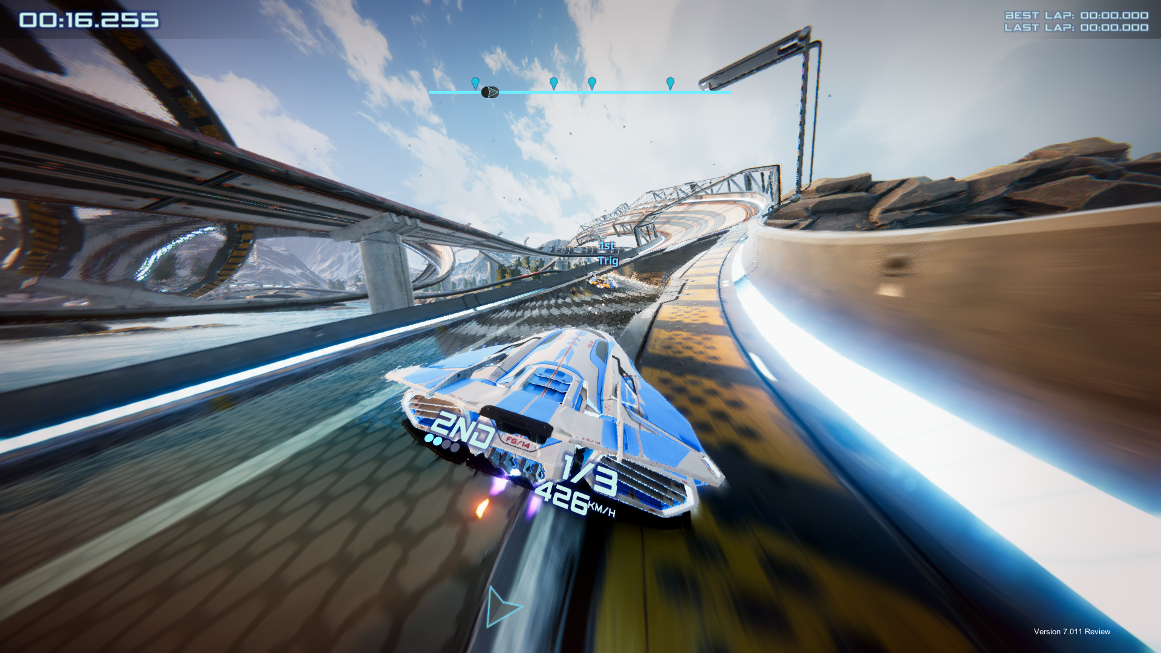
The Race Track
The race track is the most important part of the game and each and every element of the track was designed in blender .
The track has been leviated over the terrain in order to give the game a groovy look .
The track comprises of multiple light layouts that have been inserted using unity lights itself that gives the game a shape .

Slide 20
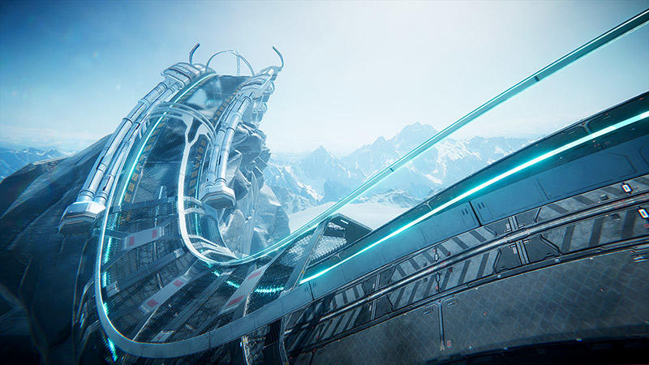
Track net mesh
Basic track support
Unity lights
Neon post processing

Slide 21
Final Run

